Slide 1

AMCAT DATA ANALYSIS
By Swetha Chintamaneni

Slide 2
About me
Background : B.Tech (Electronics and Communication Engineering)(2016-2020) - JNTUH College of Engineering.
While working in TCS, I fumbled upon the depth of Python and its applications. There I knew about data science. I was inspired to delve into the field of data science when I realized it plays a crucial role in analyzing health data, tracking disease trends, and developing predictive models to support public health initiatives and disease prevention.
I have work 2 years of Work Experience in IT field as a Python Developer in TCS.
My Linkedin url:
https://www.linkedin.com/in/swetha-c-4660a51b7
My Git url:
https://github.com/Swetha-CT/AMCAT_DATA_ANALYSIS

Slide 3
Agenda:
Business Problem and Use case domain understanding(If Required)
Objective of the Project
Summary of the Data
Exploratory Data Analysis:
Data Manipulation Steps
Univariate Analysis Steps
Bivariate Analysis Steps
Key Business Question
Conclusion (Key finding overall)
Q&A Slide

Slide 4
Business Problem Statement
Problem Statement: Predicting Salary Levels for Job Seekers Based on Various Attributes
Key Questions to Explore:
What are the significant factors influencing salary levels among job seekers?
Are there any correlations between educational qualifications, specialization, and salary levels?
How do personal characteristics such as gender, age, and location impact salary expectations?
Can we identify any trends or patterns in salary distributions across different job designations and cities?

Slide 5
Objective of the Project
To analyze the factors influencing salary levels among job seekers and develop a predictive model to estimate salary based on various attributes.
Key Goals:
Identify Influential Factors: Explore the dataset to identify the key factors that significantly affect salary levels among job seekers. This includes factors such as education, skills, experience, location, and personal characteristics.
Develop Predictive Model: Build a predictive model that accurately estimates salary levels based on the identified factors. This involves preprocessing the data, selecting appropriate features, and training various machine learning algorithms to predict salary.
Model Evaluation: Evaluate the performance of the predictive model using appropriate metrics such as mean absolute error (MAE), root mean squared error (RMSE), or R-squared. Ensure that the model provides reliable predictions and generalizes well to unseen data.
Insights Generation: Extract actionable insights from the analysis to understand the relative importance of different factors in determining salary levels. This includes identifying trends, correlations, and patterns in the data.
Recommendations: Provide recommendations for job seekers and employers based on the insights gained from the analysis. This may include advice on negotiating salary packages, understanding market trends, and making informed hiring decisions.
Expected Outcome:
The expected outcome of the project is a well-performing predictive model that accurately estimates salary levels for job seekers based on their attributes. Additionally, the project aims to provide valuable insights into the factors influencing salary levels, enabling better decision-making for both job seekers and employers in the job market.

Slide 6
Summary of the Data
The dataset provided for analysis contains information about candidates who have applied for various roles within an IT company. Here is a summary of the key aspects of the data:
Size: The dataset consists of 3998 x 39 Shape , with each row representing a unique candidate and each column representing different attributes or features associated with the candidates.
Variables: The dataset includes both numerical and categorical variables. Numerical variables may include attributes such as salary, GPA, test scores, and personality traits scores. Categorical variables may include gender, degree, specialization, job city, and others.
Range and Distribution: For numerical variables, it's important to examine the range and distribution of values to understand the spread and variability within the data. This includes calculating descriptive statistics such as mean, median, standard deviation, minimum, and maximum values.
Outliers: Identification and analysis of outliers within the dataset are crucial as they may significantly impact the analysis and interpretation of results. Outliers should be carefully examined to determine whether they are genuine data points or errors that need to be addressed.
Frequency Distribution: For categorical variables, analyzing the frequency distribution provides insights into the distribution of different categories and their relative proportions within the dataset. This helps in understanding the composition of the candidate pool in terms of gender, educational background, specialization preferences, etc.
Relationships: Exploring potential relationships between variables, such as gender and specialization preferences or salary and educational qualifications, can provide valuable insights into patterns and trends within the data.
Overall, summarizing the data involves gaining a comprehensive understanding of its key characteristics, distributions, and relationships, which forms the foundation for further analysis and insights generation.

Slide 7
Exploratory Data Analysis:
Approach:
Data Preprocessing: Clean the data, handle missing values, and encode categorical variables.
Exploratory Data Analysis (EDA): Conduct exploratory analysis to understand the distribution of salary levels and relationships between variables.
Feature Engineering: Create new features or transform existing ones to improve model performance.
Model Building: Develop predictive models (e.g., linear regression, decision trees, or ensemble methods) to predict salary levels based on the identified features.
Model Evaluation: Evaluate model performance using appropriate metrics such as mean absolute error (MAE) or root mean squared error (RMSE).
Interpretation and Insights: Interpret model results to understand the relative importance of different features in predicting salary levels.
Recommendations: Provide recommendations for job seekers and employers based on the insights gained from the analysis.
Expected Outcome: The expected outcome is a predictive model that can accurately estimate salary levels for job seekers based on their attributes. Additionally, the analysis will provide insights into the factors influencing salary expectations, enabling better decision-making for both job seekers and employers in negotiating compensation packages.

Slide 8
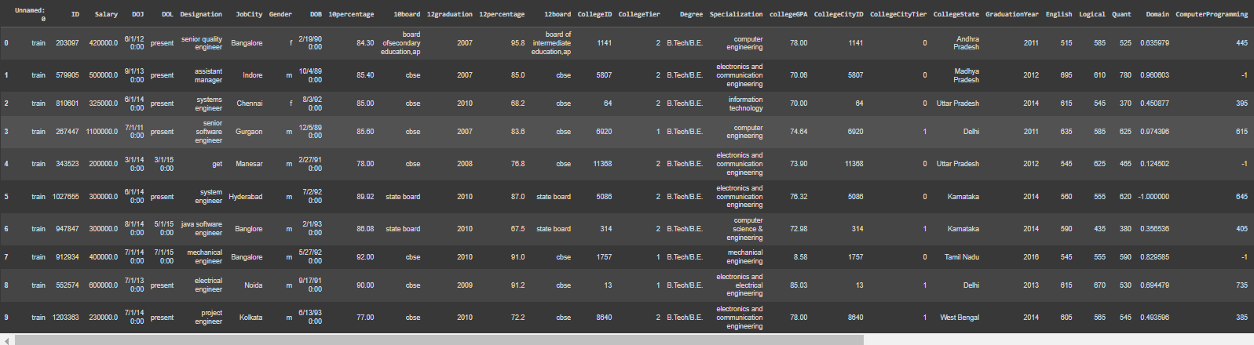
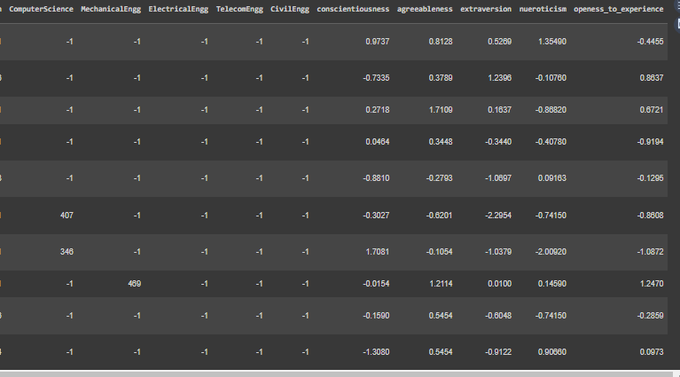
Cleaned Data Set

Slide 9
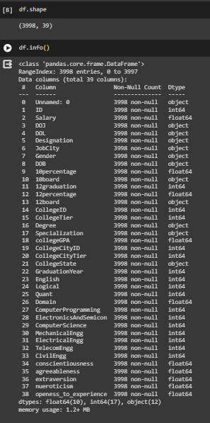
Data Info and Stats
The Shape of the data set is 3998 * 39
There are no null values

Slide 10

Data Visualization : A method of displaying data in graphs, charts and maps to make data easy to understand for those unfamiliar with the data set.

Slide 11
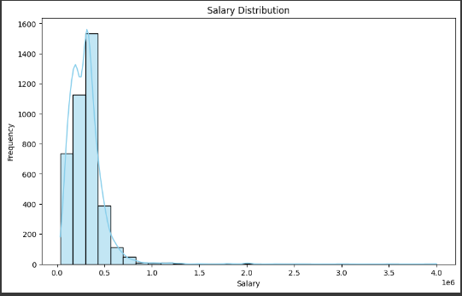
Salary Distribution
We can see that there is left skew in the frequency.

Slide 12
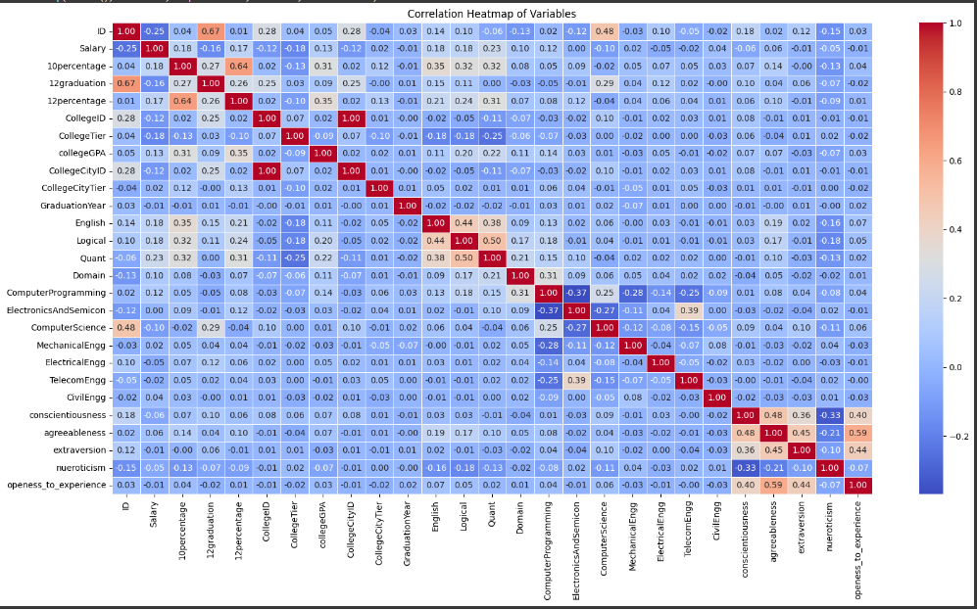
What are the significant factors influencing salary levels among job seekers?
We can see the multiple correlation between each other columns.

Slide 13
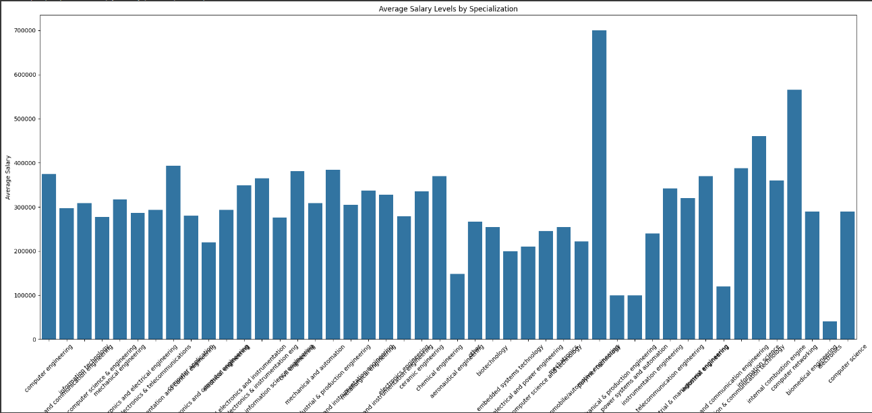
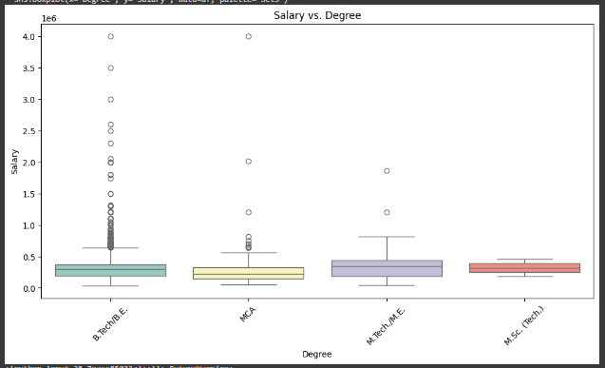
2. Are there any correlations between educational qualifications, specialization, and salary levels?
We can see that B.Tech and M.Tech Students has the most of the salary distribution.
Computer Science and technology stream students achieve highest avg of Salary

Slide 14
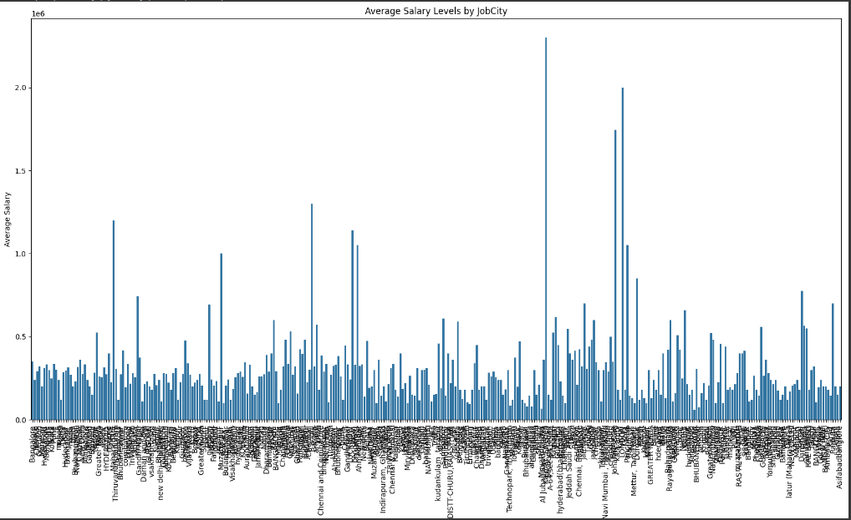
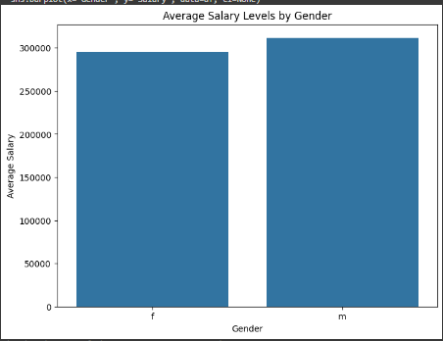
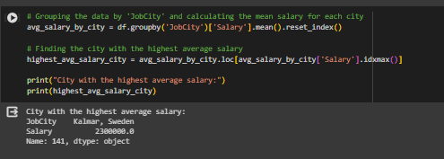
3. How do personal characteristics such as gender, age, and location impact salary expectations?
Sweden and kalmar has the highest average salary.

Slide 15
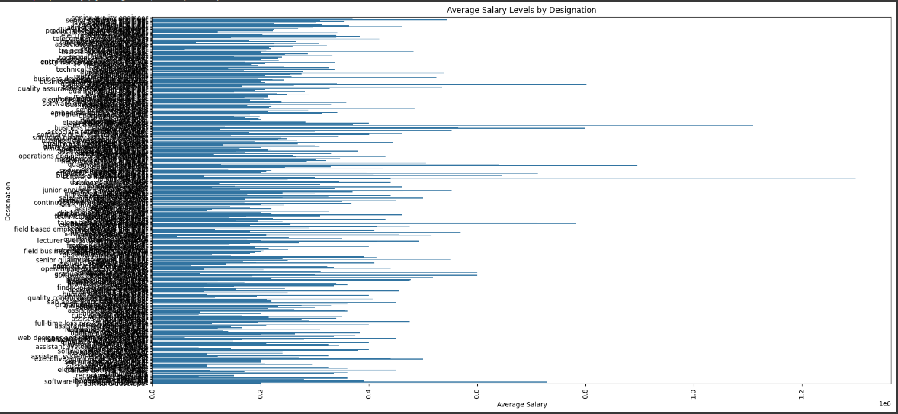
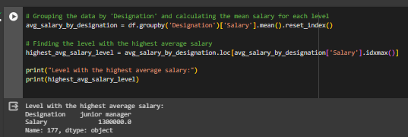
4. Can we identify any trends or patterns in salary distributions across different job designations and cities?
Junior manager Designation have the highest average Salary when compared to others.

Slide 16
Conclusion
Certainly! Here's a simplified conclusion with five key points for your presentation:
Conclusion:
Education Matters: Our analysis highlights the significance of educational qualifications in determining salary levels. Individuals with specialized degrees tend to command higher salaries, emphasizing the importance of investing in education for career advancement.
Gender Disparities Persist: Gender-based pay gaps continue to exist in the job market, with our analysis revealing discrepancies in salary levels between male and female employees. Addressing these disparities remains a critical priority for achieving workplace equity.
Location Matters: Job location plays a crucial role in salary determination, with certain cities offering higher average salaries than others. Understanding regional salary trends can inform decisions regarding job relocation and career opportunities.
Career Path Insights: By identifying job roles with the highest average salaries, our analysis provides valuable insights into potential career paths and opportunities for professional growth. Job seekers can leverage this information to make informed decisions about their career trajectories.
Data-Driven Decision-Making: Our data analysis underscores the importance of data-driven decision-making in navigating the job market. By leveraging insights from our analysis, both job seekers and employers can make informed choices to optimize career outcomes and recruitment strategies.

Slide 17
Some Q& A
Q: What was the main objective of your project?
A: The main objective of our project was to analyze factors influencing salary levels among job seekers and provide insights to aid decision-making for both job seekers and employers.
Q: How did you approach the data analysis process?
A: We began by preprocessing the dataset to clean and prepare the data for analysis. We then conducted exploratory data analysis (EDA) to understand the distribution of variables and identify trends and patterns. Finally, we built predictive models to estimate salary levels based on various attributes.
Q: What were some of the key findings from your analysis?
A: Some key findings from our analysis include the significant impact of educational qualifications and specialization on salary levels, gender disparities in salary, the influence of job location on salary, and insights into potential career paths based on salary levels.
Q: How can the insights from your analysis be applied in real-world scenarios?
A: The insights from our analysis can be applied by job seekers to make informed decisions about career choices, negotiate salary packages, and identify potential career paths. Employers can also leverage these insights to optimize recruitment strategies, benchmark salary offerings, and address diversity and inclusion challenges in the workforce.
Q: What are the potential future directions or areas for further research?
A: Future research could explore additional factors influencing salary levels, such as years of experience, industry sector, or company size. Continuous monitoring of salary trends and market dynamics can also provide valuable insights for stakeholders in the job market.

Slide 18

THANK YOU

